Slide 1
CAR Calibration Meeting CAR Review
AP Team C
Ronald Tse, Samantha Bang, Joe Lee, Catherine Qiu
December 03, 2015

Slide 2
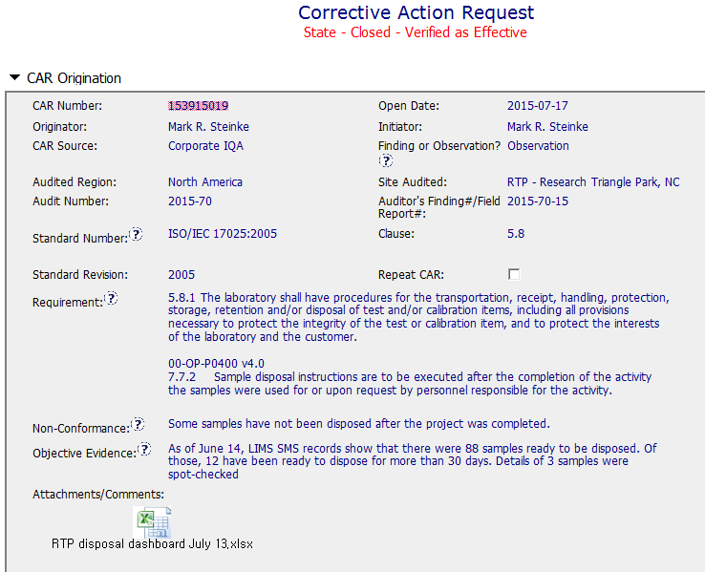
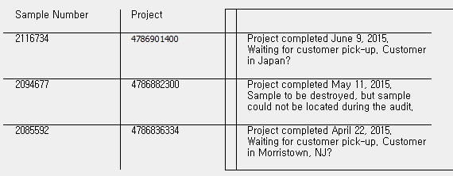

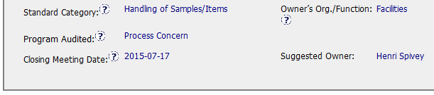
CAR 153915019
Attachment with information provided as the evidence
Good Information for CAR owner
Notes:
5.8 – Sample disposal

Slide 3
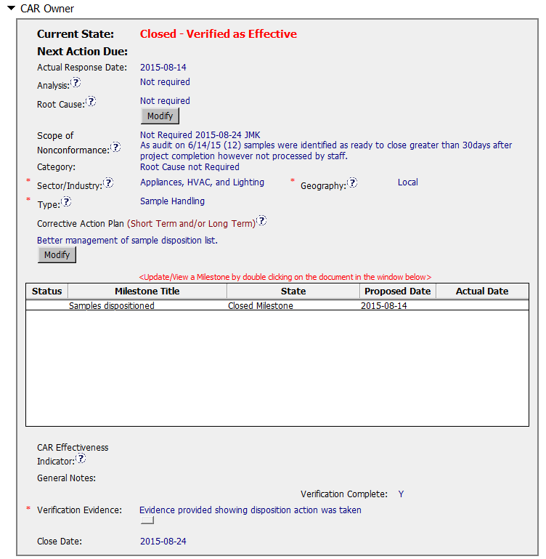
CAR 153915019
Following the procedure regarding to Analysis, Root cause, Scope and category.
Recommendation: Additional comments in the Scope field could be moved to another place like General Notes in the Milestone.
Fixing the objective evidence
Verification :
Occurred immediately after acceptance of the last milestone

Slide 4
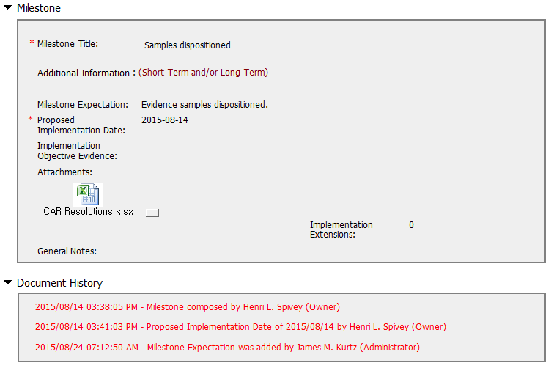
CAR 153915019
Completed per milestone expectation
Implementation evidence was attached to prove the milestone

Slide 5
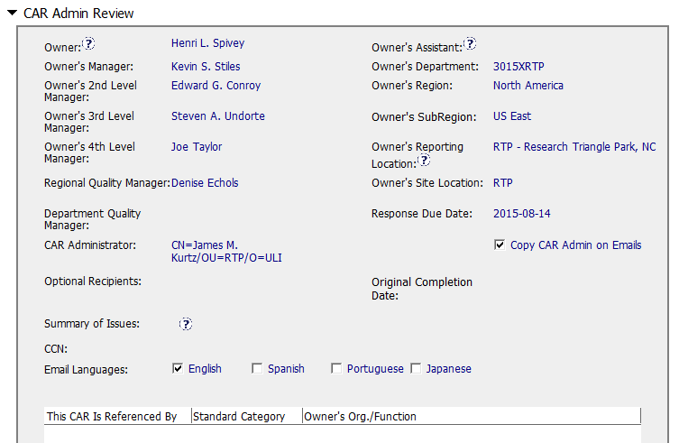
CAR 153915019
CAR Champion remembered changing president's name to Joe.

Slide 6
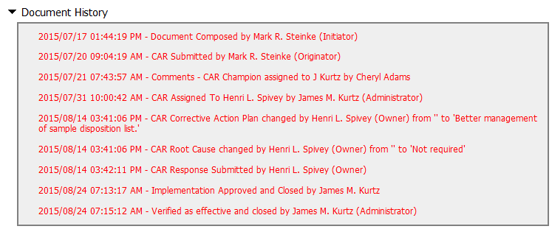
CAR 153915019

Slide 7
CAR 153915019 – CBS Check
CBS Requirements | Excellent | Moderate | Need Improve | N/A
(C) Extensions are within requirement (<30 days, 3 or less) |  |  |  | √
(T) Most appropriate ‘category’, ‘type’, ‘geography’ are selected | √
(P) Facilitates the handling of disputed CARs |  |  |  | √
(T) Acts on CARs within required timeframe | √
(C) Analysis shows clear path to root cause and scope; stakeholders identified |  |  |  | √
(C) Root cause statement is succinct, reasonable, complete (Shows ‘N/A’ for observations) |  |  |  | √
(C) Corrective actions fix the objective evidence and other problems found; address entire root cause and scope. For observations, they do not go beyond fixing the objective evidence | √
(C) Milestones address containment & owner’s verification; completed per milestone expectations | √
(P) Verification per requirements | √
(L) Referenced communications are attached as needed | √
(C L) Evidence of communication for overdue/escalated CARs and other pertinent concerns |  |  |  | √
(P) Trains other CAR Champions |  |  |  | √

